Slide 1
Module 15: Cache Management
Analytics: Server Architect (Siebel 7.7)
Notes:
Time: Lecture: approximately 25 minutes; labs: see Lab Guide for timings.
Intent: To describe the fundamentals of a query cache and to explain the different techniques of managing the cache.
Flow: Define the advantages of caching, configure a query cache, and describe methods for managing the cache.
Key Terms:
Query cache
Cache file
Cacheable
Non-cacheable
Cache Manager
MAX_ROWS_PER_CACHE_ENTRY
MAX_CACHE_ENTRIES
15

Slide 2

Module Objectives
After completing this module you will be able to:
  Manage cache files
Why you need to know:
  Cache management techniques are useful for maintaining and enhancing query performance
Notes:
Each objective and “why you need to know” should be stated aloud.

Slide 3

Caching Query Results
Query execution sometimes requires large amounts of database processing
Siebel Analytics Server saves query results in cache files
  A query is evaluated to determine if it qualifies for a cache hit
    Fulfilling a user’s query from existing results stored in the cache instead of being satisfied by the database
  Cache files are stored in location as defined in the NQSConfig.INI file
Notes:
Once a query request has been executed for the first time, the Siebel Analytics Server saves the results of that query in cache files and then reuses those results later when a similar query is requested. By using the cache, the database only needs to be processed once for the initial time a query is executed. For subsequent times that a similar query is executed, the results are satisfied by the cache and not the database.
15

Slide 4
Caching Advantages
Eliminates redundant queries run on the database
Query performance
  Using cached results eliminates having to access database
    Frees up database server to perform other tasks
  Faster response time when fulfilling a query from the cache versus searching through the database
Network
  Conserves network resources by avoiding connection to the database server
Notes:
The fastest way to process a query is to skip the bulk of the processing and use a pre-computed answer. With query caching, Siebel Analytics Server stores the pre-computed results of queries in a local cache. If another query can use those results, all database processing for that query is eliminated. This can result in dramatic improvements in the average query response time.
In addition to improving performance, being able to answer a query from a local cache conserves network resources and processing time on the database server. Network resources are conserved because the intermediate results do not have to come over the network to the Siebel Analytics Server. Not running the query on the database frees the database server to do other work.
Administrators can take additional steps to improve caching performance. Such measures might include tuning and indexing databases, optimizing data source connectivity, leveraging aggregate tables, and efficiently constructing metadata.

Slide 5
Query Cache
Location where query results are stored
  Each cache file stores metadata and results of the request
Cache metadata is evaluated to determine if new query can:
  Use stored results, referred to as a cache hit, or
  Use database for new results
User’s query request is translated into logical request
Siebel Analytics Server
Cache
Metadata
(Cache hit?)
Server
Database
If cache miss, the request is queried against the database; results are stored in cache and sent to user
Logical Request
No
The metadata is searched to identify a match (cache hit)
Yes
Query
Cache
Return
Result
If there is a match, results are retrieved from the cache and sent to the user
Notes:
A query cache is a facility that stores the results from queries. If a query is fulfilled by the results stored in the cache, it is called a cache hit.
A cache is used to eliminate redundant queries back to the database. For example, if 10,000 users always look at the same dashboard, getting the data once and storing it in the cache helps with scalability.
This illustration depicts the basic architecture of the query cache. The process of accessing the cache metadata occurs very quickly. If the metadata shows a cache hit, the bulk of the query processing is eliminated, and the results are immediately returned to the user. The process of adding the new results to the cache is independent of the results being returned to the user; the only effect on the running query is the resources consumed in the process of writing the cached results.
15

Slide 6
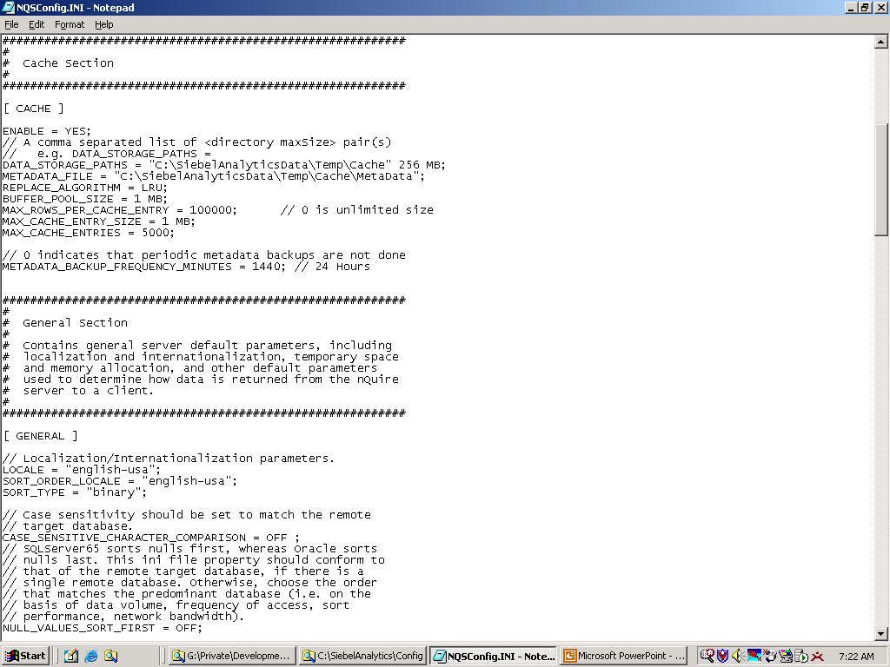
Configuring Query Cache
Enable and configure cache storage in NQSConfig.INI file
  Specify directory for query cache storage
    Should be local, high-performance, high-reliability storage device
Set enable parameter to YES
Specifies directory for query cache storage
File stores metadata about queries stored in cache
Notes:
Caching is enabled in the NQSConfig.INI file, within the CACHE section as shown in the illustration. To enable caching, an administrator will need to set the value of the ENABLE parameter to YES.

Slide 7
Cache Files
Always produce the same results, even after the database has been updated
Issues with retaining cache files may arise
  Not purging outdated caches, known as stale caches, can potentially return inaccurate results over time
  Sizable consumption of disk space
    Can be managed by defining the maximum rows per cache entry and maximum number of cache entries in NQSConfig.INI
Notes:
If the cache entries are not purged when the data in the databases changes, queries can potentially return results that are out of date because of the stale data that exists.
The query cache requires dedicated disk space. The amount of space depends on the query volume, the size of the query result sets, and how much disk space you choose to allocate to the cache. You can affect disk space by entries in the NQSConfig.INI file [Cache] section:
MAX_ROWS_PER_CACHE_ENTRY = 100000; // 0 is unlimited size
MAX_CACHE_ENTRY_SIZE = 1 MB;
MAX_CACHE_ENTRIES = 1000;
For performance reasons, a disk should be used exclusively for caching, and it should be a high performance, high reliability type of disk system.
15

Slide 8
Cache Management Techniques
0/8
Configuring cache parameters
Restricting tables as non-cacheable
Using Cache Manager
Modifying column display
Inspecting cache report
Purging cache entries
Inspecting query SQL
Using event polling tables
Notes:
This is a structuring slide that addresses various approaches to purging and managing the cache. Details are addressed on subsequent slides.
An administrator must decide what level of stale data is acceptable and what is not and develop a plan for purging the non-current information.

Slide 9
Configuring Cache Parameters
1/8
In the NSQConfig file, specify the query volume, size of the query results, and disk space allocated for caching
  When disk space has reached its limit, entries least recently used (LRU) are discarded to make space for new entries
Specify limits allowed in the cache
Notes:
When determining parameter limits, analysis needs to be done to determine how large average queries are and how many cache entries are generally created between data loads.
The DATA_STORAGE_PATHS parameter specifies the directories for query cache storage. These directories are used to store the cached query results and are accessed when a cache hit occurs. Leading practice suggests that the cache storage directories should reside on high performance storage devices, ideally devoted solely to cache storage. When the cache storage directories begin to fill up, the entries that are least recently used (LRU) are discarded to make space for new entries.
The METADATA_FILE parameter stores information about queries stored in the cache. The Siebel Analytics Server creates and continually updates the metadata file.
An administrator can control the maximum number of rows for any cache entry and the maximum number of cache entries with the MAX_ROWS_PER_CACHE_ENTRY and MAX_CACHE_ENTRIES parameter, respectively. If the number of rows a query returns is greater than the value specified in the MAX_ROWS_PER_CACHE_ENTRY parameter, the query is not cached.
15

Slide 10
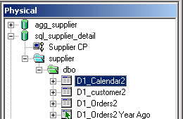
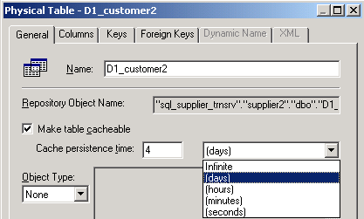
Restricting Tables as Non-Cacheable
2/8
By default, all tables in the database are cacheable
  Cache entry is created if the table has been queried against
Time until a cache entry is purged from file
Supplier database tables
Remove check so that any query made against this table is not cached
Notes:
By default, because a table is “cacheable” it is possible, when that table is being queried against, for the results of the query to be added to the cache. This allows similar queries to be fulfilled by the cache in the future.
In some instances, however, it may not make sense to keep cache entries after a certain amount of time has elapsed. For this reason, an administrator can set a time limit that a cache entry has before it is purged from the file. This is accomplished by using the Cache Persistence time field as seen in the screen shot.
Still, in other cases, it may not make sense to produce a cache at all when a table is being queried against. In this case, an administrator could indicate that a table in “non-cacheable” by removing the check from the Make table cacheable check box. By making a table non-cacheable, any query against that table will not be added to the cache.
Defining tables as non-cacheable is generally used only when there are tables that change very frequently, such as a real-time subject area.

Slide 11
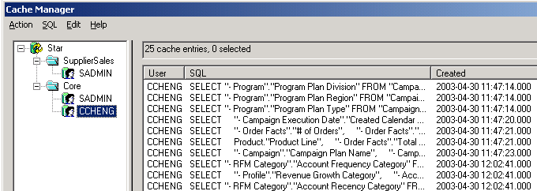
Using Cache Manager
3/8
Monitors the entire query cache
  Administrators can view cache entries by category (for example, repository, subject area, and user)
Allows administrators to manually purge entries by user or by physical table
Active in Online mode only
Parent object displays entire list
Cache queries
Selecting child object displays only the queries associated to it
Notes:
The Cache Manager is accessed from the Siebel Analytics Administration Tool, which needs to be in online mode. The Cache Manager is a way for administrators to manage the server query cache.
15

Slide 12
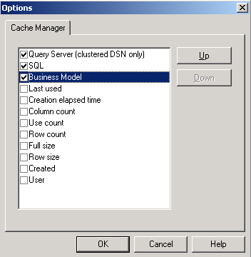
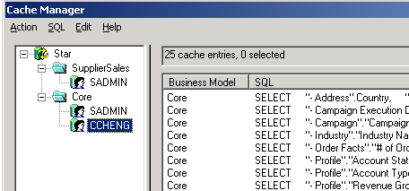
Modifying Column Display
4/8
Administrators can modify columns displayed in the Cache Manager
  Uncheck a column to remove it from display
  Promote or demote the order in which a column displays
Select Edit > Options
Click Up to promote or Down to demote selected column
Notice that the Business Model column has been promoted
Notes:
Administrators can alter how the Cache Manager displays information. The Options window allows the administrator to select the columns they want the Cache Manager to display by checking or unchecking the columns. An administrator can set the order in which they are displayed by selecting a column and clicking the Up or Down buttons.

Slide 13
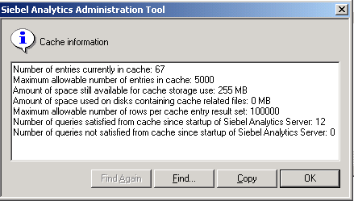
Inspecting Cache Report
5/8
Provides administrators with performance information about the system
  Select Action > Show Info from the Cache Manager window
Monitor both space used and available, delete cached queries when necessary
Queries not satisfied may affect performance
Notes:
This slide illustrates how an administrator can see an overall report on the cache status.
15

Slide 14
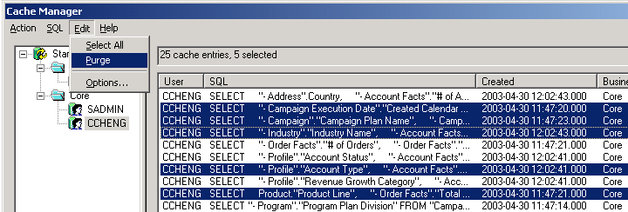
Purging Cache Entries
6/8
Allows administrators to manually purge selected entries or the entire query cache
  Use the CTRL key to specify certain cache entries
  Select Edit > Select All to select entire cache
Notes:
In reality, the production system should have an automated technique to for purging the cache. However, manually purging is a nice feature for administrators, especially during development. During development and testing, an administrator may need to quickly purge all of the cache.

Slide 15
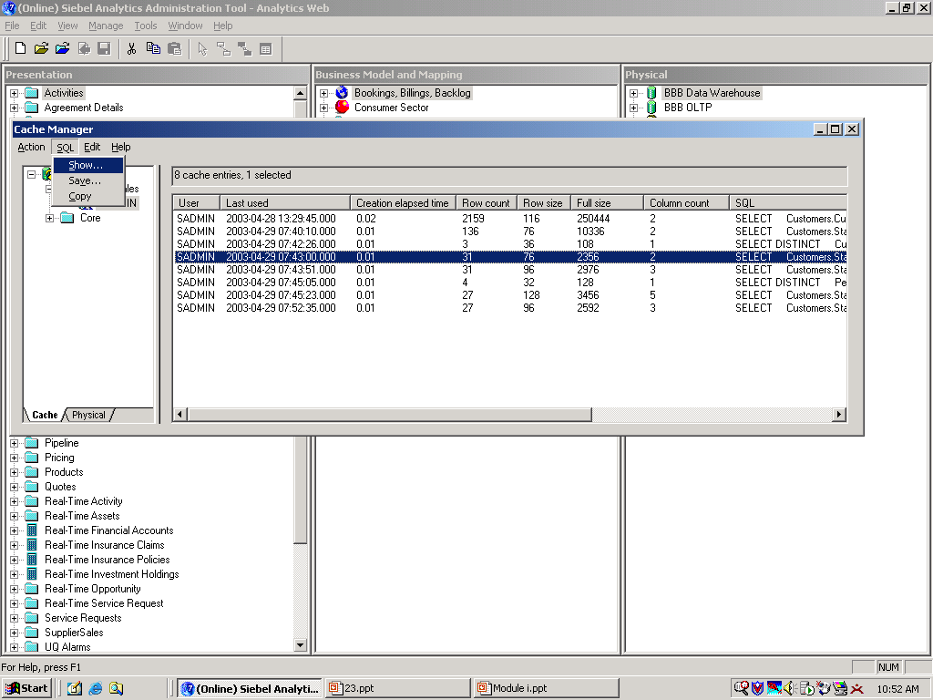
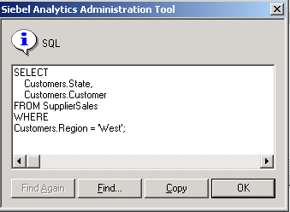
Inspecting Query SQL
7/8
Is useful in development or troubleshooting a potential issue
Useful in evaluating cache statistics
To view the Query SQL:
1. Select the query
2. Select SQL > Show
Notes:
The SQL for a request can assist in evaluating cache statistics. For example, you realize that a cache entry has fulfilled 90 other requests and you may want to know the SQL behind this entry, in order to create other requests that are just as effective.
To see the logical SQL used by the query, click on the query and the choose SQL > Show from the menu.
15

Slide 16
Using Event Polling Tables
8/8
Event polling tables store information about updates in underlying databases
Analytics Server polls table at set intervals and invalidates any cache entries corresponding to updated tables
Can be sole method of cache management or be used with other cache-management techniques
Caution: There will always be a polling interval in which the cache is not completely up-to-date
  Result: Potential for stale data in cache
For information about setting up event polling tables on physical databases, see the Query Caching section of the
Siebel Analytics Server Administration Guide.
Notes:
Siebel Analytics Server event polling tables store information about updates in the underlying databases. An application (such as an application that loads data into a data mart) could be configured to add rows to an event polling table each time a database table is updated. The Analytics Server polls this table at set intervals and invalidates any cache entries corresponding to the updated tables.
The use of a Siebel Analytics Server event polling table (event table) is a way to notify the Analytics Server that one or more physical tables have been updated. Each row that is added to an event table describes a single update event, such as an update occurring to the Product table in a Production database. The Siebel Analytics Server cache system reads rows from, or polls, the event table, extracts the physical table information from the rows, and purges stale cache entries that reference those physical tables.
The event table is a physical table that resides on a database accessible to the Siebel Analytics Server. Regardless of where it resides—in its own database, or in a database with other tables—it requires a fixed schema. It is normally exposed only in the Physical layer of the Administration Tool, where it is identified in the Physical Table dialog box as being a Siebel Analytics Server event table.
If data in a table is updated more frequently than the polling interval, and current data is the only thing that is acceptable, then do not cache results from that physical table.

Slide 17
Consideration: Using a Cache Hit
A cache hit occurs when certain conditions are satisfied:
  Resultant table of a new query is equivalent to or subset of the cache
  Query is at the same level or higher level than cache
  WHERE clause constraint is equivalent to or subset of the cache
  SELECT list columns of a new query are equivalent to those in the cache
  SELECT list columns composed of expressions of a new query are equivalent to those in the cache
Notes:
These are conditions that need to be met in order for a cache hit to occur. Briefly review each condition.
15

Slide 18
Summary
This module showed you how to:
  Manage cache files
Notes:
Review Questions:
Question: What is a query cache?
Answer: The results of a query request that have been stored so that it might fulfill a similar request in the future
Question: What is a cache hit?
Answer: When a query is fulfilled by the results stored in the cache
Question: Where would I define the parameter values for the cache?
Answer: In the NSQConfig.INI file
Question: How would I configure tables so that they are not cacheable?
Answer: You would first need to select the table and open its properties window. You would then need to uncheck the Make table cacheable field.

Slide 19
Lab
In the lab you will:
  Configure cache parameters
  Review and delete cached queries using the Cache Manager
Notes:
Lab Tips and Troubleshooting:
See Lab Guide for details.
15

